Slide 1
you’re on board the flight to
The Free-for-All Web and the Secret Tyrants We All Are
if this is not your intended destination, please deplane now.
me:
Deanna Zandt
http://deannazandt.com
@randomdeanna
hashtags:
#w2e
#ffaw

Slide 2
10,000,000,000,000,
000,000,000,000,000,000,000,000,000,000,000,000,000,000,000,000,000,000,000,000,000,000,000,000,000,000,000,000,000

Slide 3


Slide 4
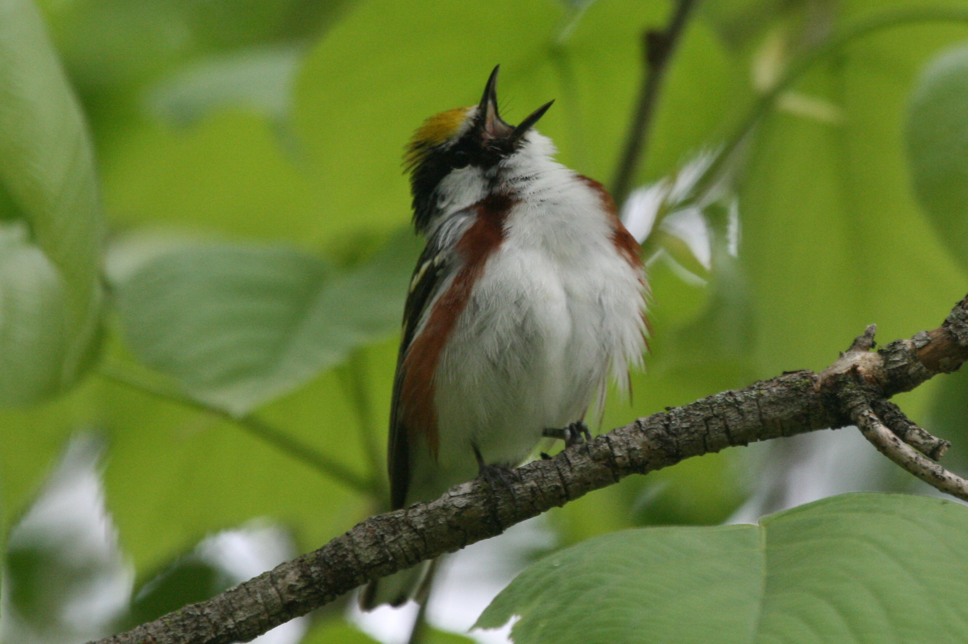

Slide 5


Slide 6


Slide 7
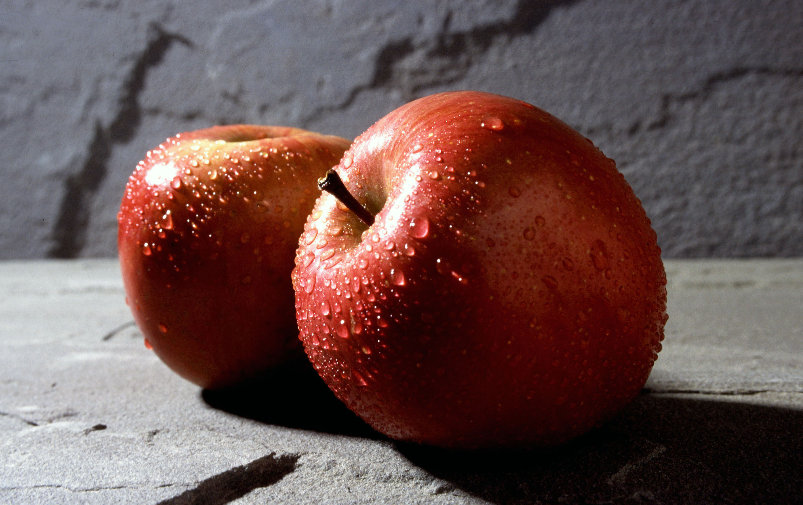

Slide 8


Slide 9

#fail

Slide 10
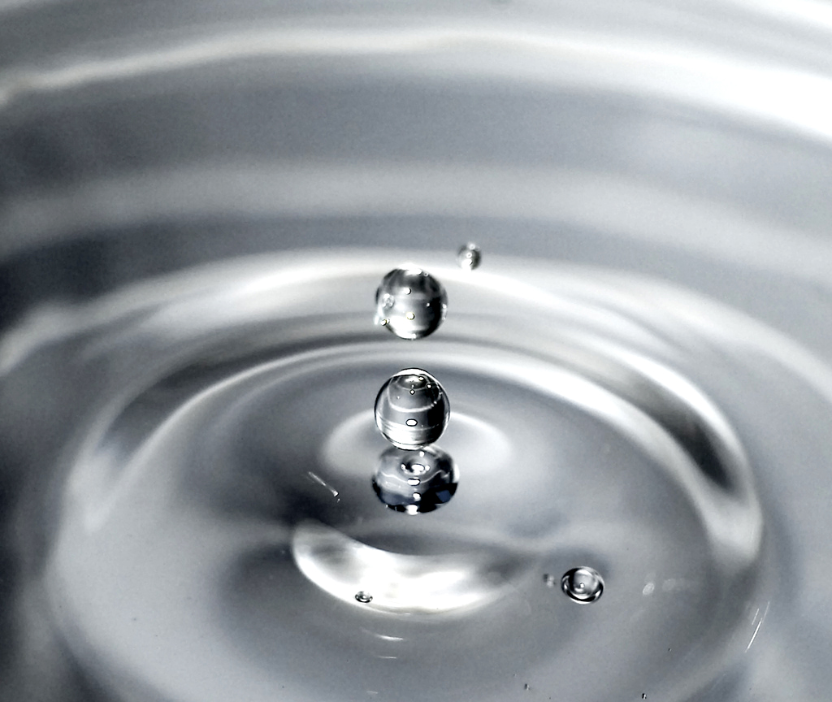
generational shift

Slide 11
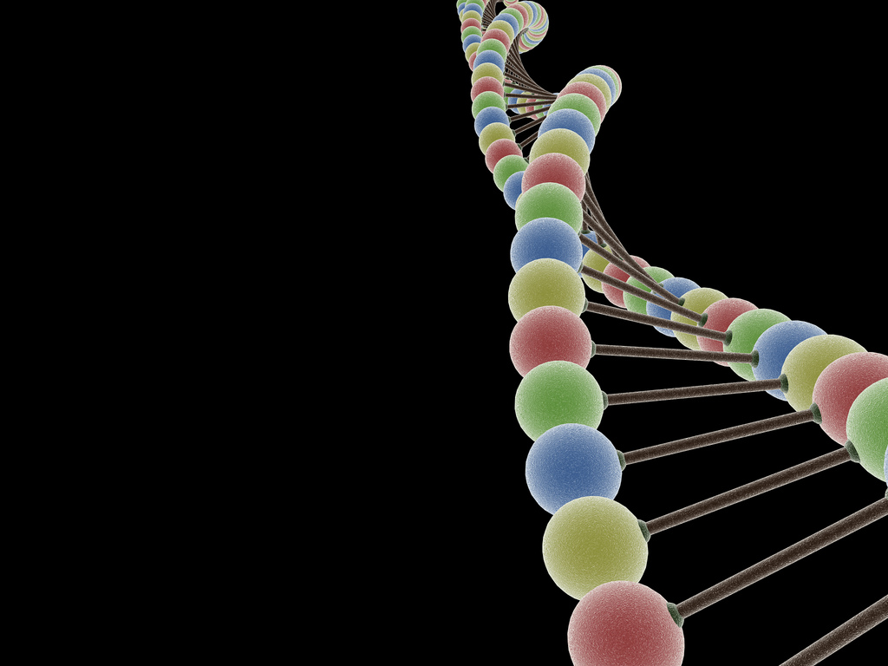
mix it up

Slide 12

=gamechanging

Slide 13


Slide 14
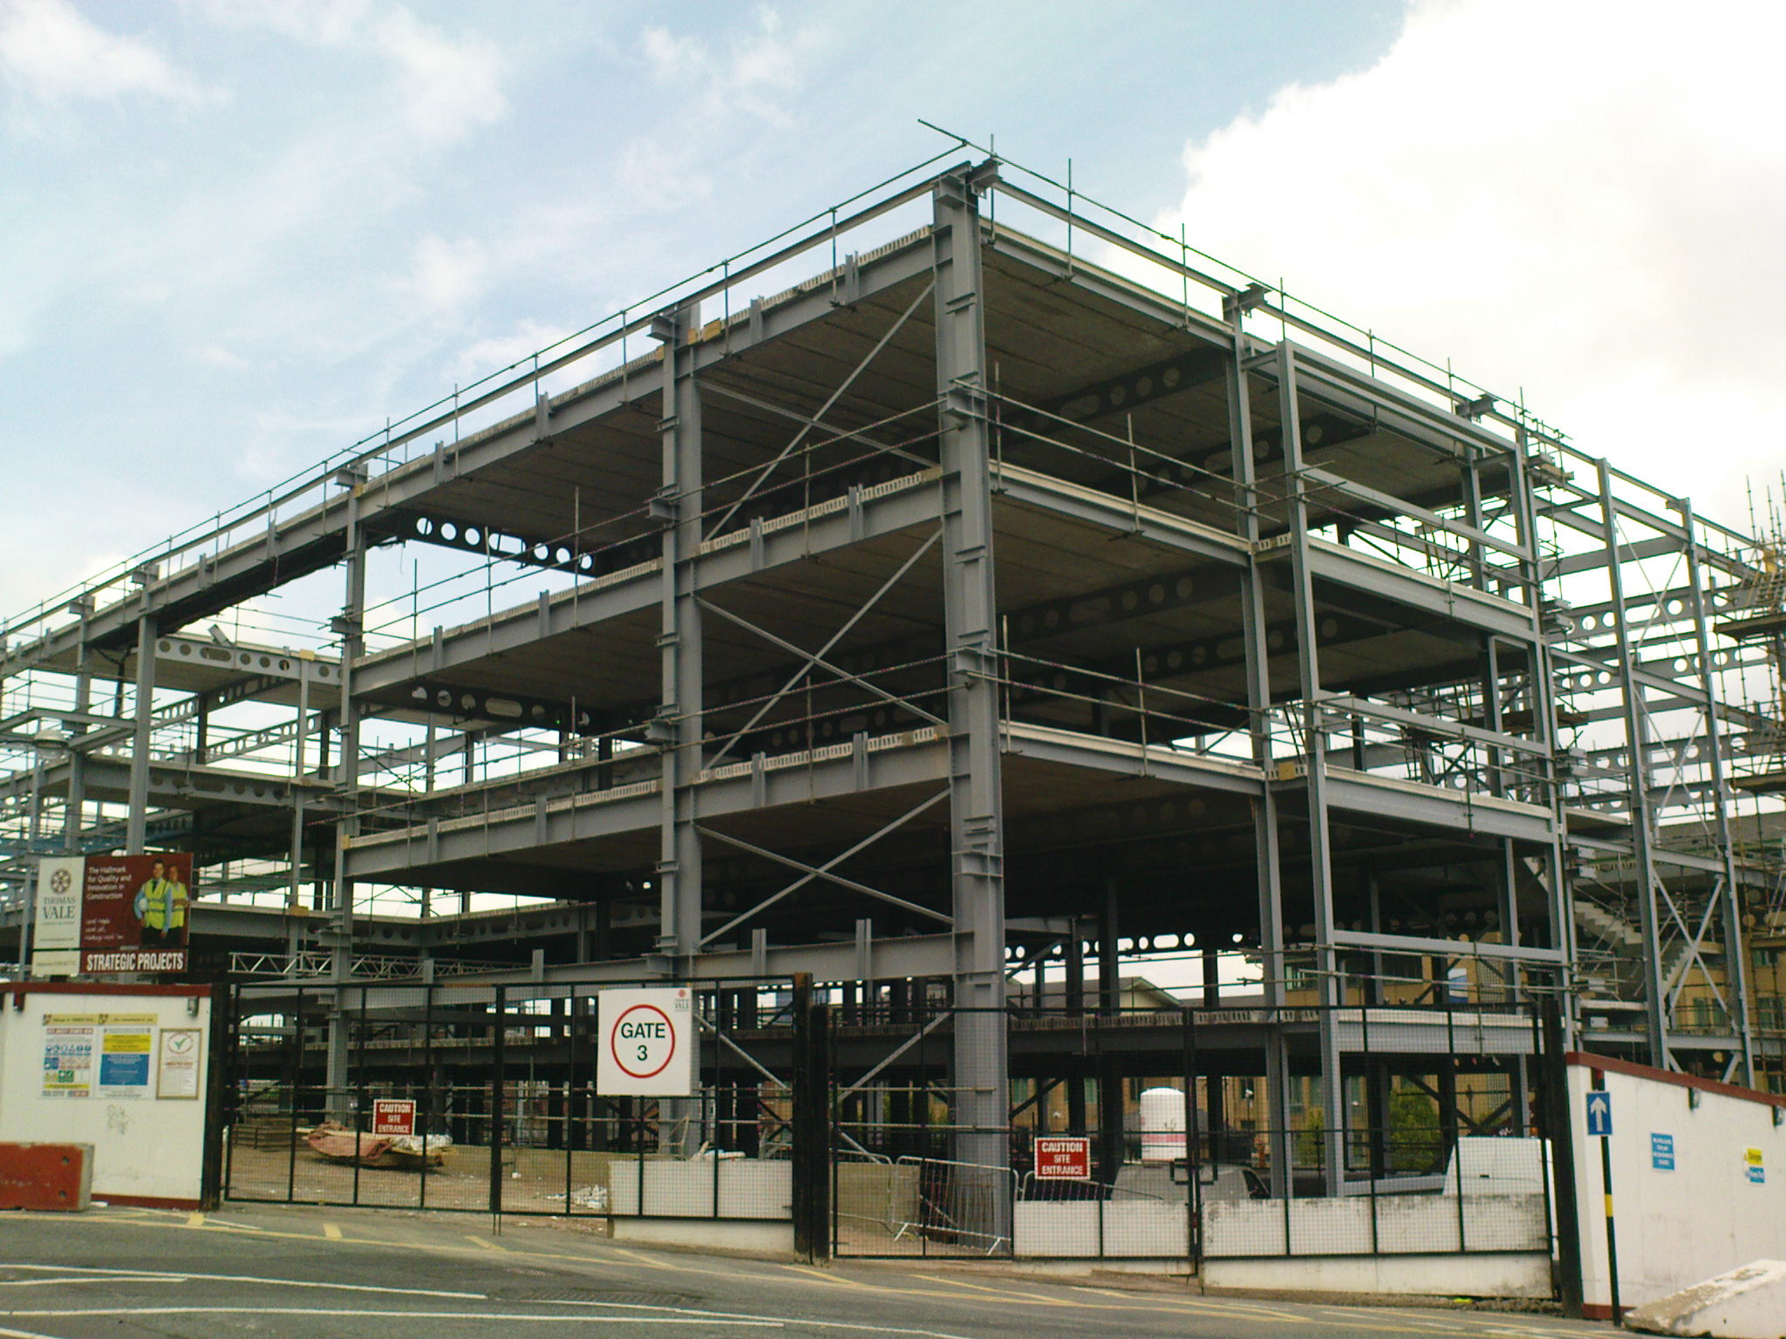
explicit structure

Slide 15
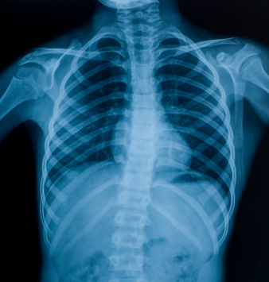
implicit structure

Slide 16
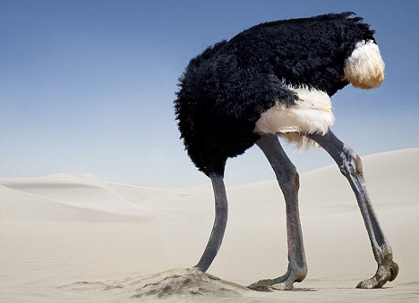
(ur doin it wrong)

Slide 17
“This means that to strive for a 'structureless' group is as useful, and as deceptive, as to aim at an 'objective' news story, 'value-free' social science or a 'free' economy. A 'laissez-faire' group is about as realistic as a 'laissez-faire' society; the idea becomes a smokescreen for the strong or the lucky to establish unquestioned hegemony over others. . . . Thus 'structurelessness' becomes a way of masking power.”
—Jo Freeman, “The Tyranny of Structurelessness”

Slide 18


Slide 19
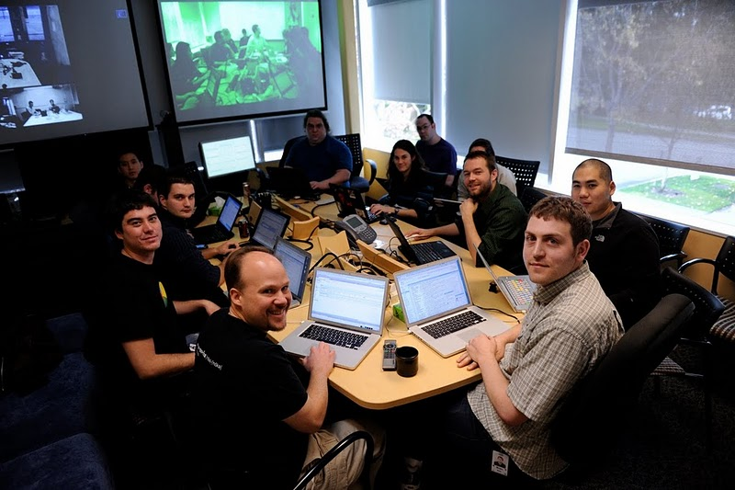
tyrants. but not evil.

Slide 20
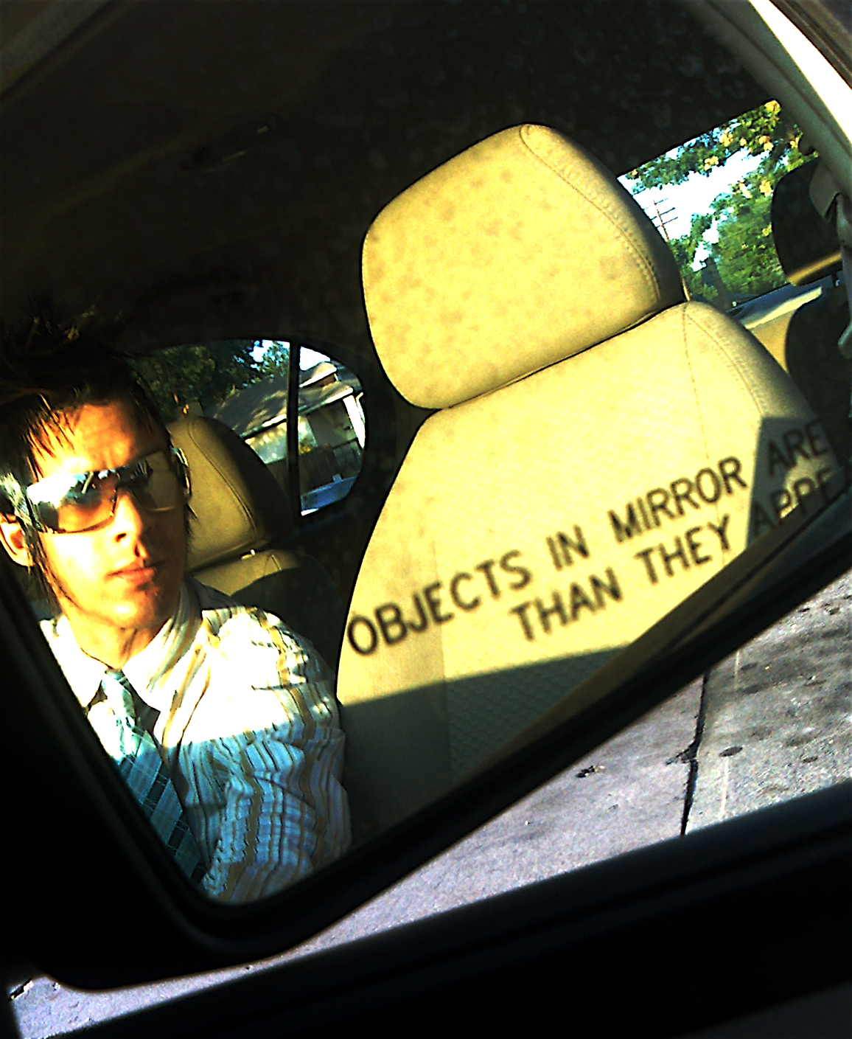
your blind spot?

Slide 21
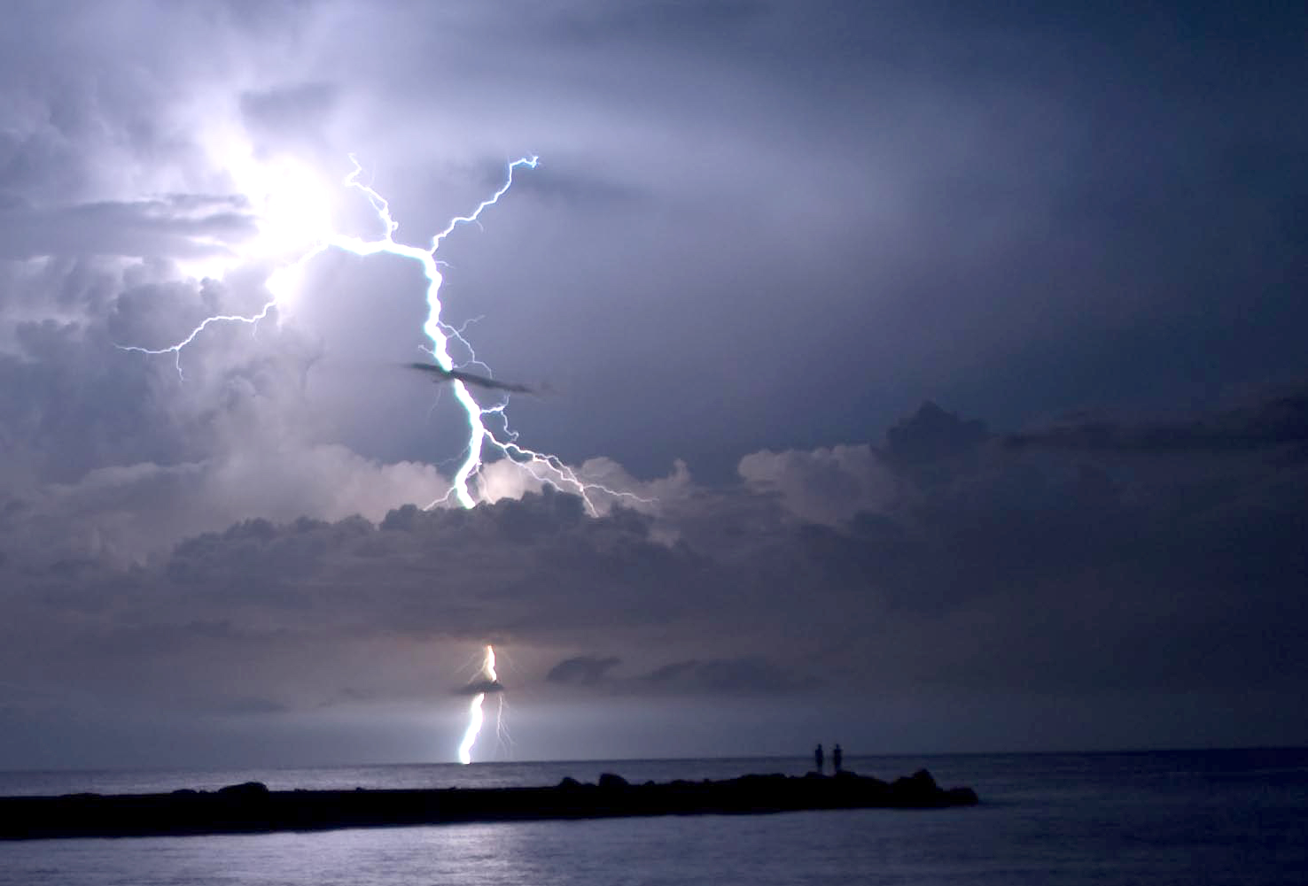
tension ≠ bad

Slide 22
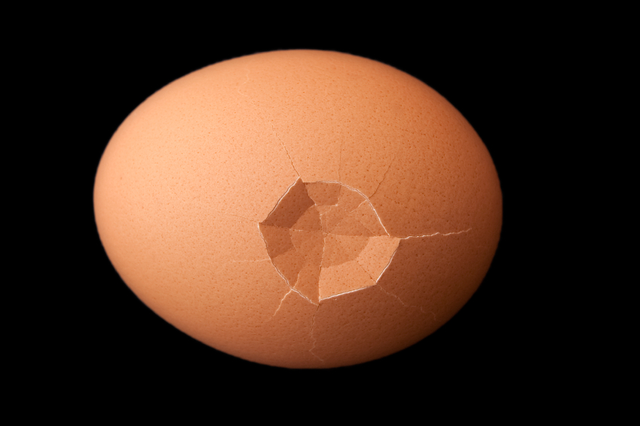
vulnerability ≠ weakness

Slide 23
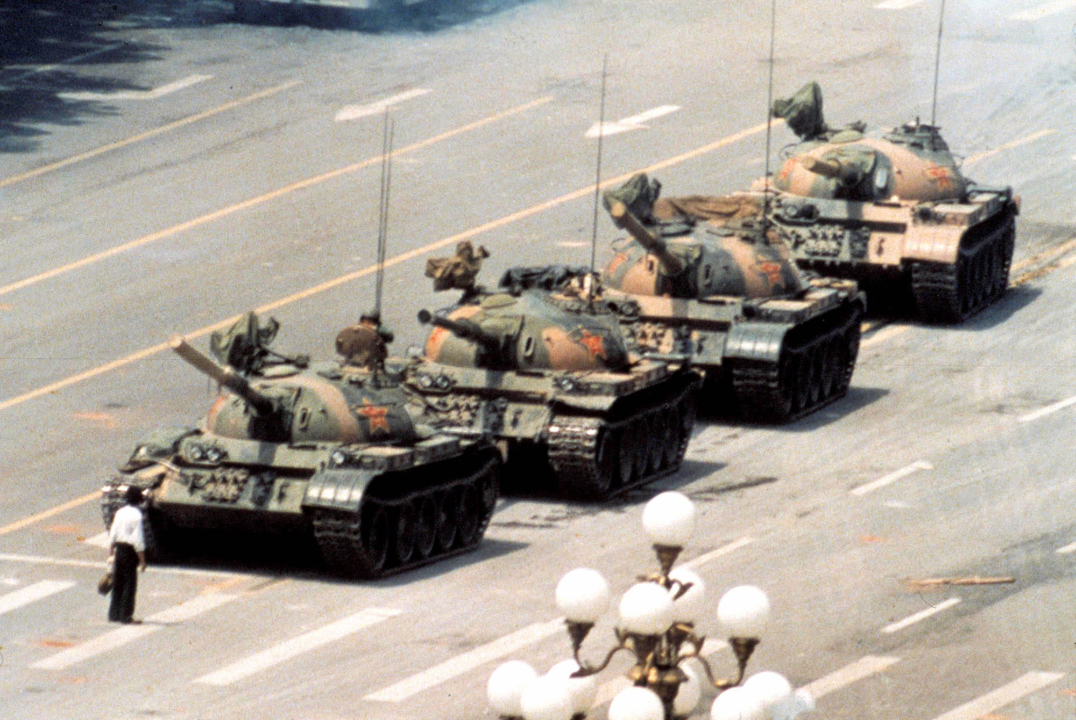
how will you
disrupt tyranny?

Slide 24
equality (uniformity)
is not
equity (fairness)

Slide 25
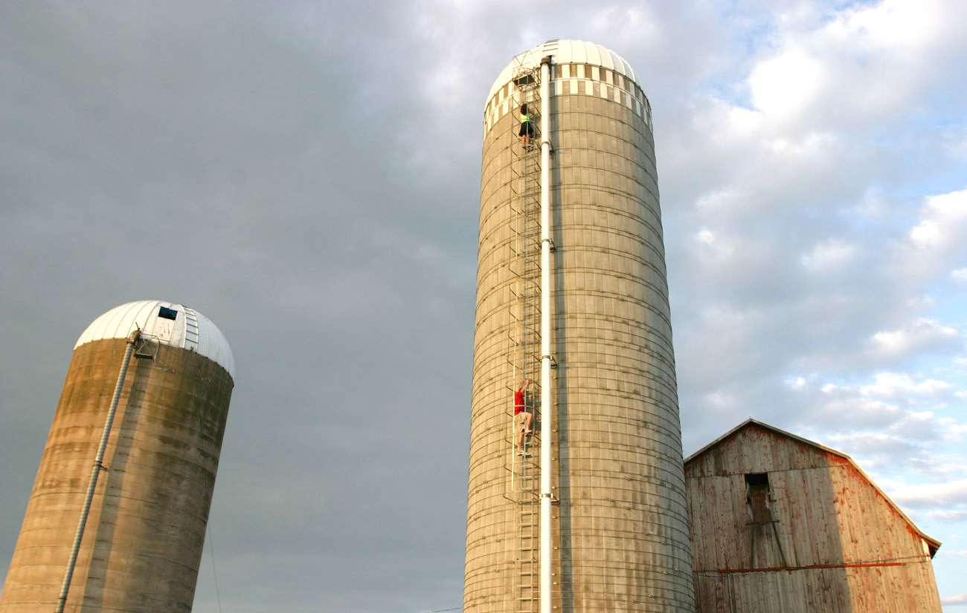
separation
breeds staleness

Slide 26

listen.

Slide 27
thank you!
this has been a presentation of
The Free-for-All Web
and the Secret Tyrants We All Are
please take all your belongings with you and have a nice day
me:
Deanna Zandt
http://deannazandt.com
@randomdeanna
hashtags:
#w2e
#ffaw

Slide 28
Photo credits:
Bird: http://www.flickr.com/photos/birdfreak/2523239162/
apple: http://commons.wikimedia.org/wiki/File:Fuji_apple.jpg
TRS-80: http://en.wikipedia.org/wiki/File:TRS-80_Color_Computer_1_front_right.jpg
ripples: http://www.flickr.com/photos/rogerss1/2875665576/
DNA: http://www.flickr.com/photos/13338351@N07/2243853949/
community: http://www.istockphoto.com/stock-photo-12148264-multiracial-hands-making-a-circle.php
women's lib: http://bp2.blogger.com/_5QiQAbZN6E8/Rmy44TADItI/AAAAAAAAABE/YNMdQUuv-zE/s1600-h/opin_femin_2212_wideweb__470x373,0.jpg
structure: http://www.flickr.com/photos/ell-r-brown/4586752387/
implicit: http://www.istockphoto.com/stock-photo-13367879-x-ray-image-of-chest.php
ostrich: http://www.dailymail.co.uk/debate/article-1264092/GENERAL-ELECTION-Neither-political-party-tell-truth.html
f*ck google: gizmodo.com
Buzz team picture: google.com
blind spots: http://www.flickr.com/photos/habdelra/1282723806/
tension: http://www.flickr.com/photos/kuzeytac/2763734090/
vulnerability: http://www.istockphoto.com/stock-photo-11723996-craked-egg.php
silo: http://www.flickr.com/photos/webethere/495888600/
listen: http://www.istockphoto.com/stock-photo-340142-brighter-tomorrow.php

